Slide 1

week 4 assignment-graphs
Baoming Hao
2021.7.15

Slide 2
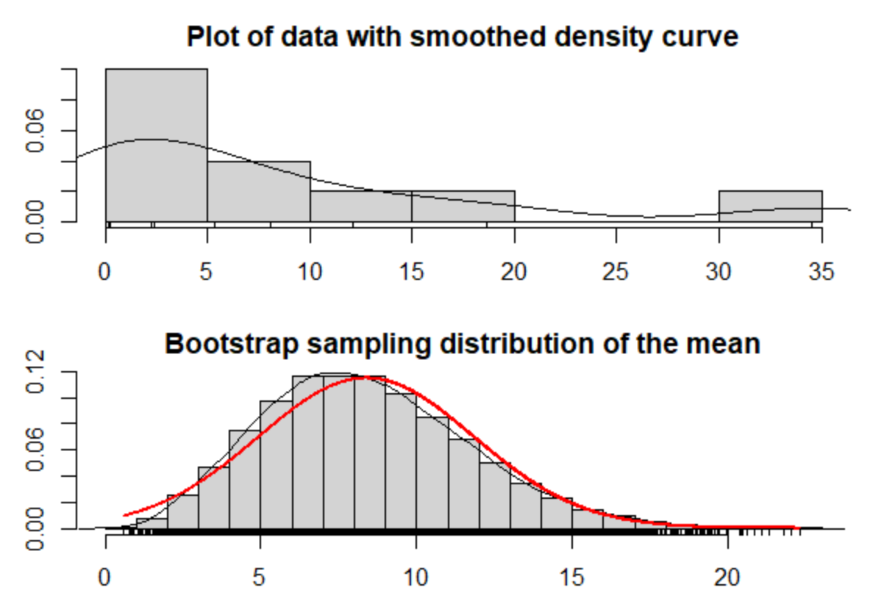
01 Assessing assumptions using the bootstrap

Slide 3
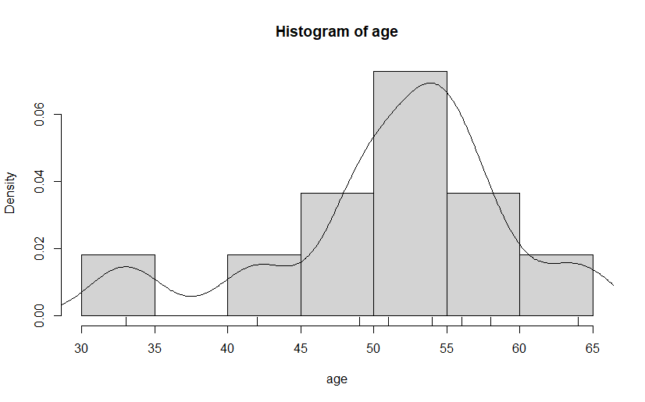
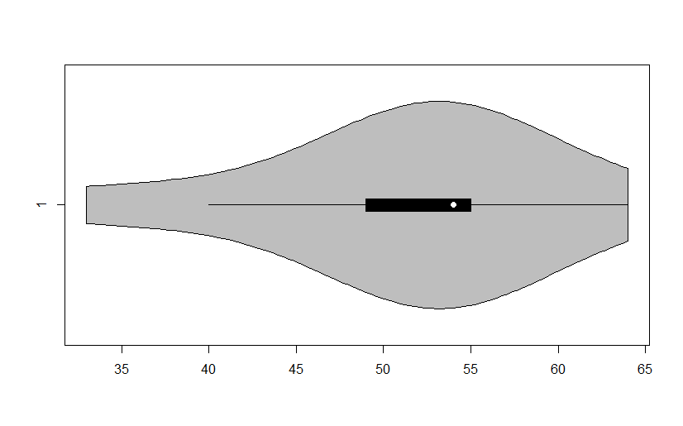
02 Example: Age at First Transplant
Page 79

Slide 4
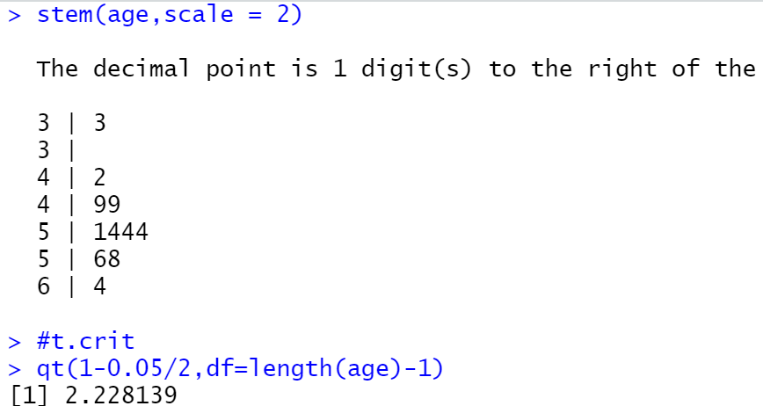
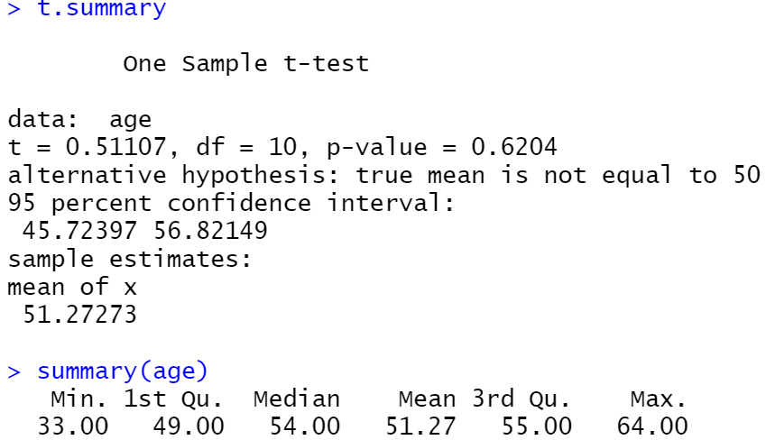
02 Example: Age at First Transplant

Slide 5
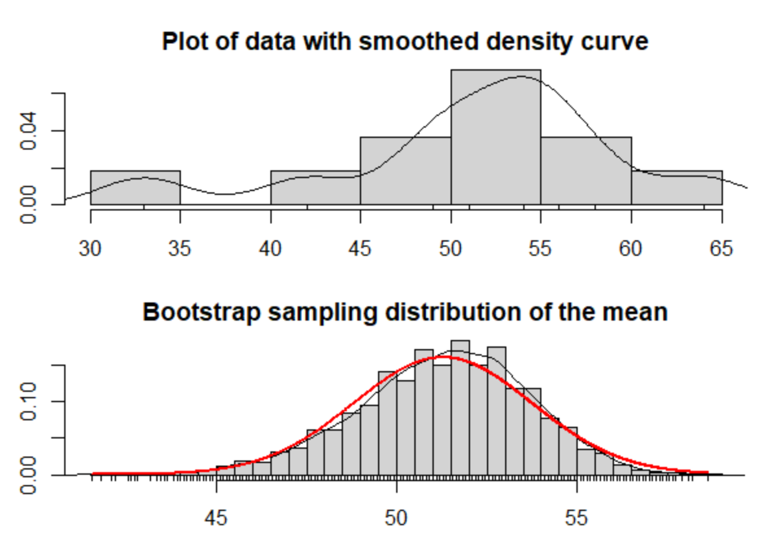
Page 80

Slide 6
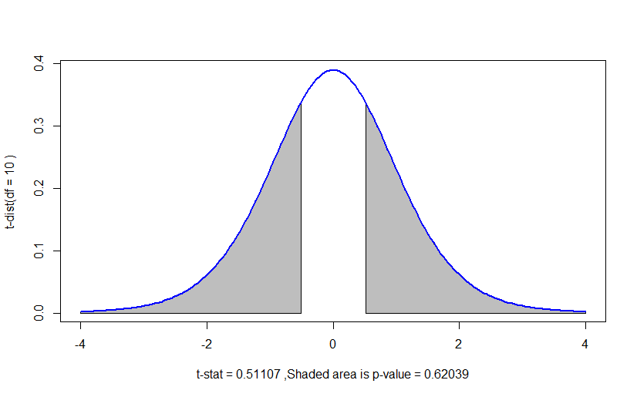
Page 81

Slide 7
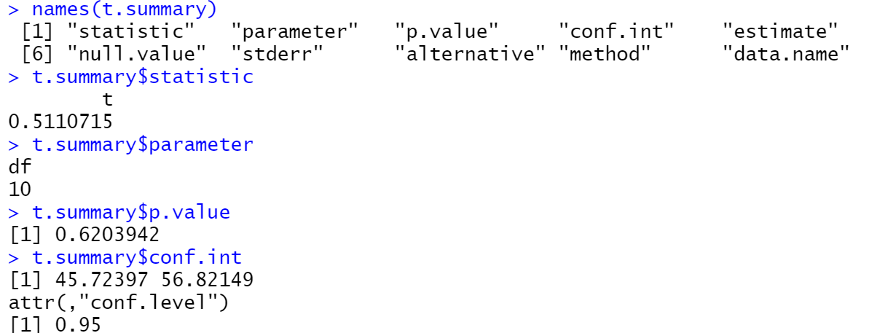
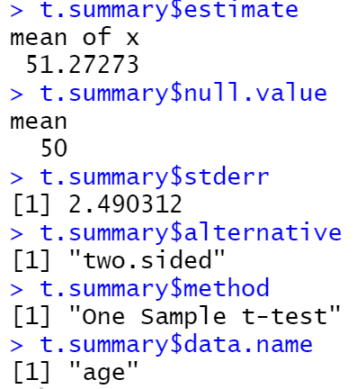

Slide 8
THANK YOU FOR WATCHING

